Slide 1


Golan Regional Council Management Application​
By Guy Edri & Eldad Shneor.
Advisor: Dr. Naomi Unkelos Shpigel
Phase II
Project Code: 24-2-D-17

Slide 2
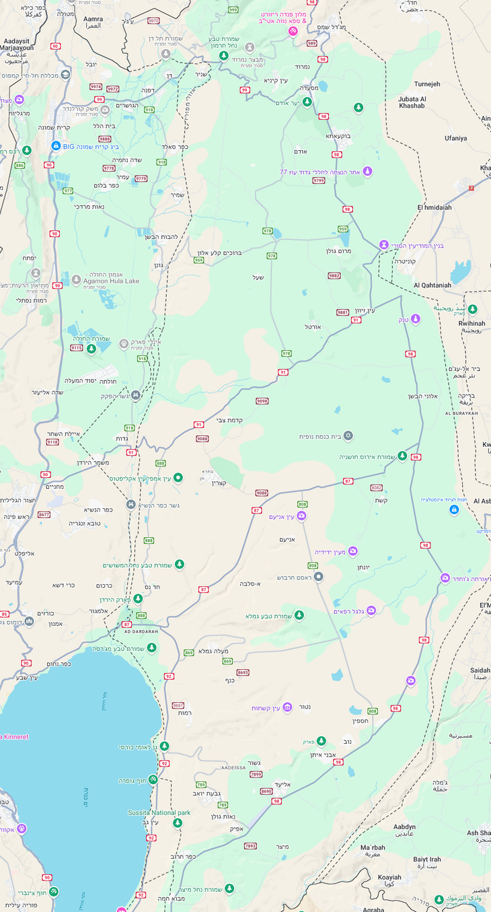
Introduction
Golan Regional council
Introduction
Golan Regional council
The Golan Regional Council has 33 villages under its jurisdiction.
The council formed a 5 year plan called Pitaron
The council, currently, has a serious problem with data management.
Projects are stored in one big, cumbersome, Excel file
Each Village has its own file with an Excel file and a Word file, containing each village data.
2

Slide 3
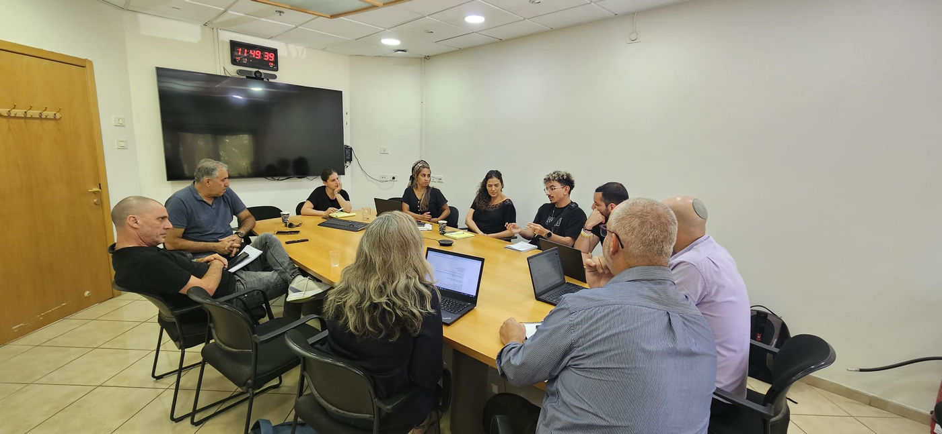
Motivation
“
Currently, comparing data across villages and projects is extremely difficult and time-consuming. I am forced to go into a huge projects file and 33 village cases and manually record the information and share it. It is highly inefficient and wastes a lot of time.
”
Yaacov Se-Lavan, Deputy Chairman of the Golan Regional Council​
3

Slide 4




The Problem
Data Management Inefficiencies
Project management
Collaboration Barriers
Separate Excel and Word files for each village
Difficult access and analysis of information
Lack of standardized project workflows leading to duplicated efforts
Lack of centralized data about projects happening in the council
Lack of coordination among council employees
Impeded information flow
Newly elected council
4

Slide 5
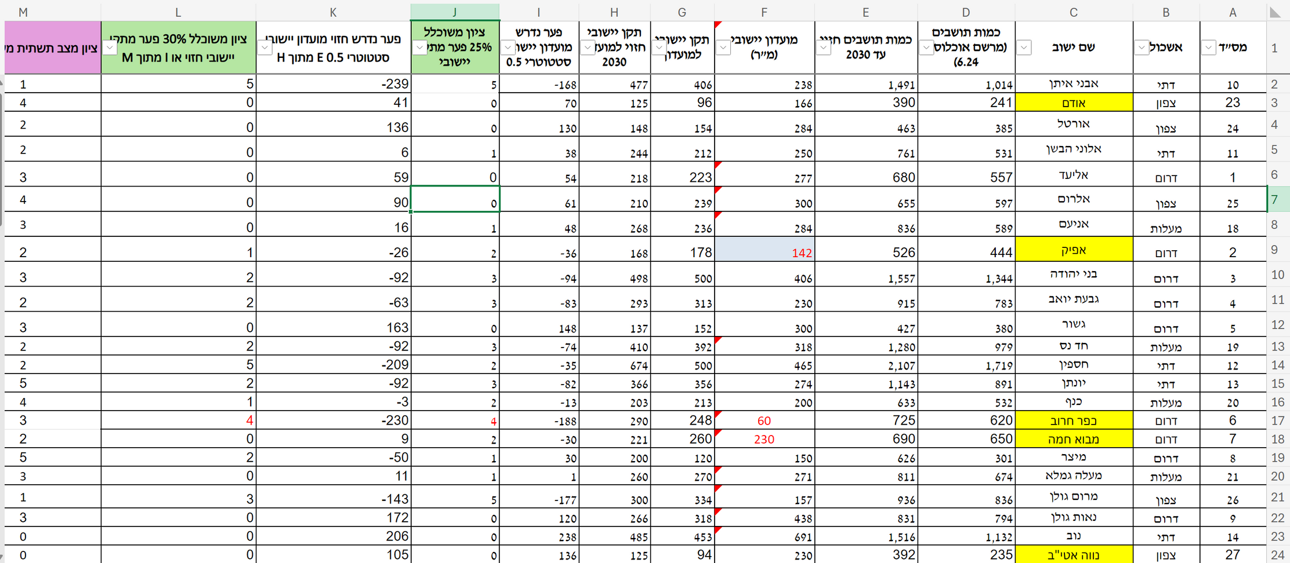
Current State of Work
Settlements Management
5

Slide 6
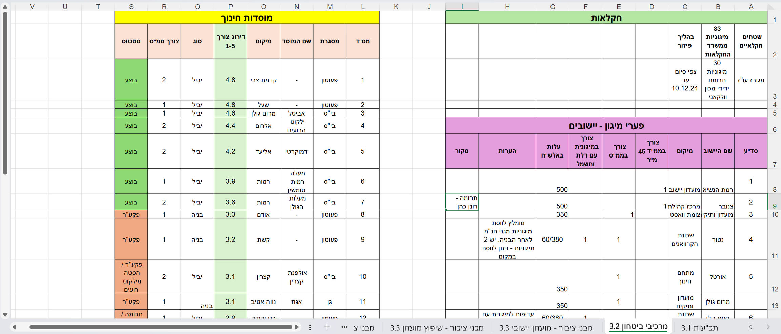
Current State of Work
Projects Management
6

Slide 7
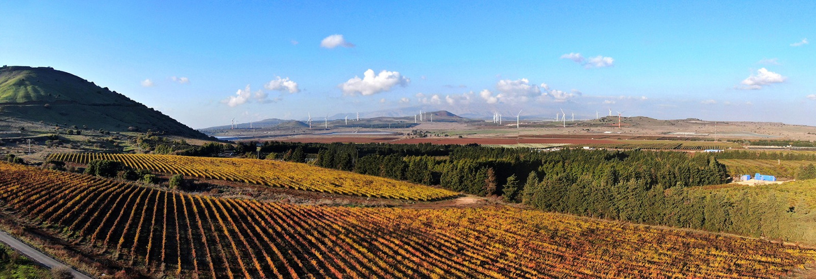







Our Solution:
Golan Application
Web-Based Application
Centralized Data Management
Project Management Module
User-Friendly Interface
“Pitaron” Plan Integration
Scalable Solution
Back to Agenda Page
7
Notes:
Lets talk about our Solution and objectives. Our system will be a web based application created with the most modern technology's. we plan on creating a responsive accessible website that will allow all devices from desktop to mobile phones
We will create a Centrailzed data management which will be a critcal role in our system this will eliminate the use of excel and pdf files per village and will store all the data in one secure place.
With the integration of the pitaron plan which is a multi year infestractor devlopment for the golan heights.
Educational, Secuirty, Roads and more

Slide 8












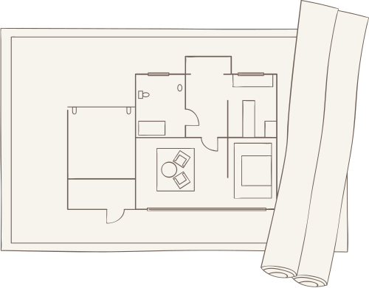
System Architecture
Client Side
Server Side
Database
Framework
Framework
Next.JS 15
Next.JS 15
React
TypeScript
&
JacaScript
Neon
PostgreSQL
User Interface Components
Azure
Kinde
Authorization
Shadcn UI
Tailwind CSS
State Management
Blob Storage
Email Service
Zustand
8

Slide 9
Working Flow Timeline
July 2024
July - September 2024
September 8th, 2024
October 2024
First meeting
Presenting Phase I
Second meeting
Research & prototype development
October 2024 - February 2025
February 25th 2025
February - March 2025
March 18th 2025
April 6th 2025
Presenting Alpha Phase to Council’s stuff, including hands-on
Presenting Phase II
Delivering Final version to the council
First sprint -
Alpha Phase
Second sprint
9

Slide 10

System Live Presentation
10

Slide 11




Challenges and Solutions
Working with
a client
Military reserve service
Storing external
files
Back to Agenda Page
Cross-device
compatibility
11
Notes:
Lets talk about our Solution and objectives. Our system will be a web based application created with the most modern technology's. we plan on creating a responsive accessible website that will allow all devices from desktop to mobile phones
We will create a Centrailzed data management which will be a critcal role in our system this will eliminate the use of excel and pdf files per village and will store all the data in one secure place.
With the integration of the pitaron plan which is a multi year infestractor devlopment for the golan heights.
Educational, Secuirty, Roads and more

Slide 12



Evaluation
Summary
Alpha Phase Presentation and impressions.
SUS Score: 85.938
Enthusiastic adoption by General Manager, Amit Cohen
Most Valued Features:
Visual graphs and Excel export
Intuitive design
Effective project categorization
Improvement Areas:
Streamline interface to reduce clicks
Add filtering options and viewer role
Implement year-based sorting
12
Notes:
An NPS score measures customer loyalty by looking at their likelihood of recommending a given business.

Slide 13



Future Enhancements
Automated reports
generator
Integrating additional council departments
Improving data analytics and graphs
Back to Agenda Page
13
Notes:
Lets talk about our Solution and objectives. Our system will be a web based application created with the most modern technology's. we plan on creating a responsive accessible website that will allow all devices from desktop to mobile phones
We will create a Centrailzed data management which will be a critcal role in our system this will eliminate the use of excel and pdf files per village and will store all the data in one secure place.
With the integration of the pitaron plan which is a multi year infestractor devlopment for the golan heights.
Educational, Secuirty, Roads and more

Slide 14
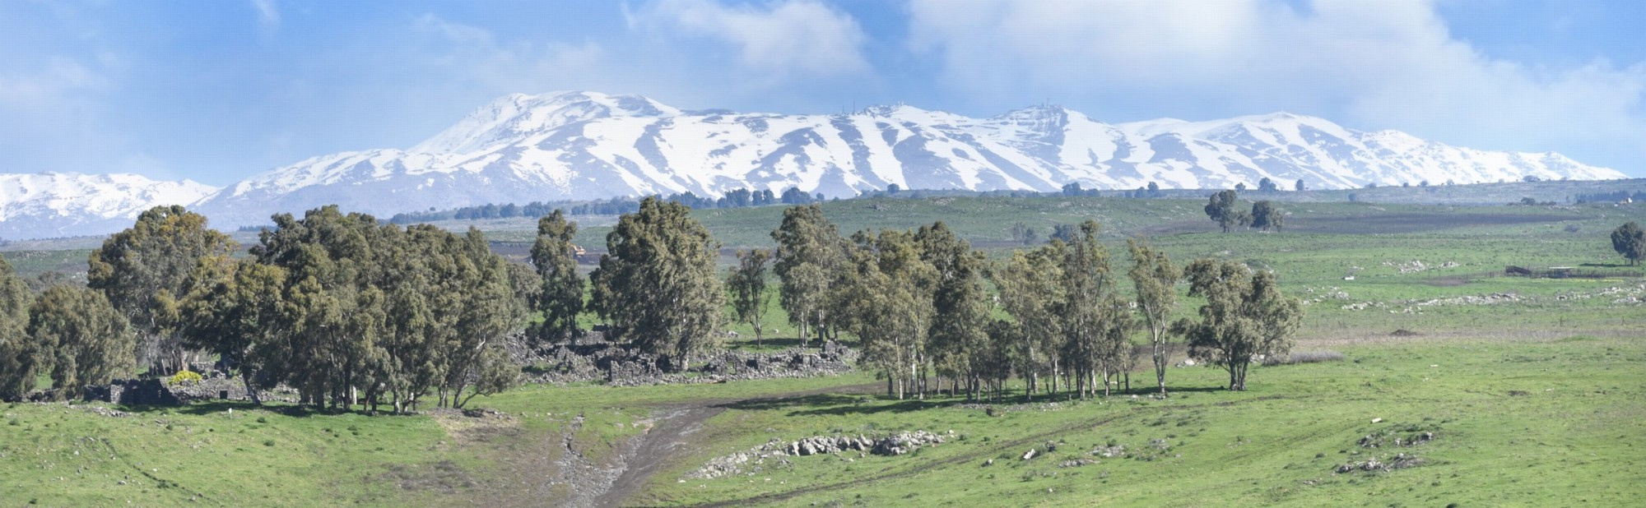
Thank you for listening!
Questions?
14

